Slide 1
Movies Database System
By Sanjana Jadhav

Slide 2
Objective of the project:
This involves managing a movie database system. The system includes tables for movies, actors, directors, movie actors, movie directors, and reviews. Your task is to create the necessary tables, insert records, and perform various SQL queries to manage and analyze the data.
Enabling data access easy for the user.
Providing a source of mass storage of data. Allowing multiple users to access the database at the same time. Providing appropriate and quick response to user queries.

Slide 3
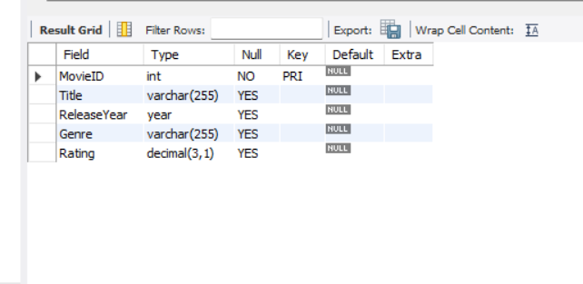
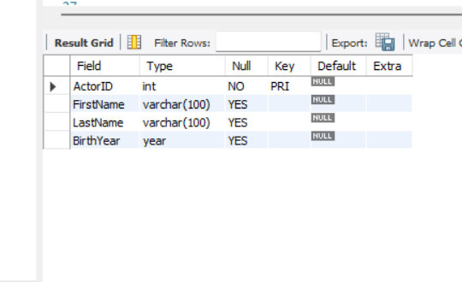
Tables in Project
Movies Table
Actors Table

Slide 4
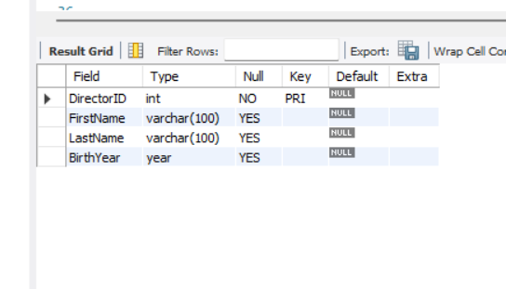
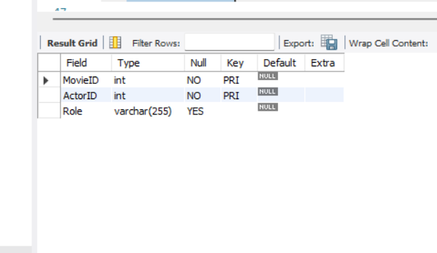
Directors Table
MovieActors Table

Slide 5
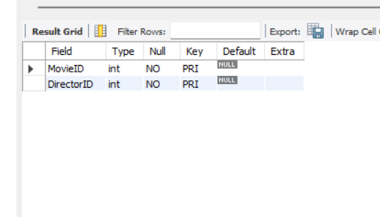
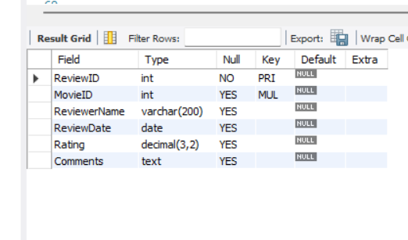
MovieDirectors Table
Reviews Table

Slide 6
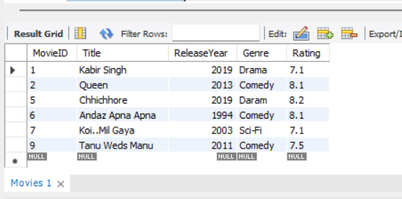
Write a query to select all movies from the Movies table where the Rating is above 7.0. Select * From Movies Where Rating > 7.0;

Slide 7
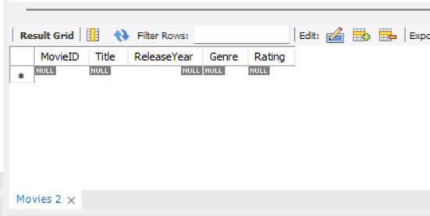
Write a query to select all movies released between 2000 and 2010 and with the genre 'Action’. Select * From Movies Where ReleaseYear Between 2000 AND 2010 AND Genre = 'Action';

Slide 8
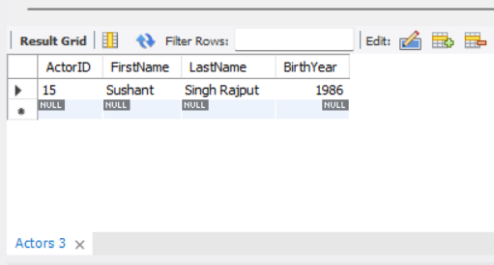
Write a query to select all actors whose LastName starts with ‘S’ Select * From Actors Where LastName Like 'S%';

Slide 9
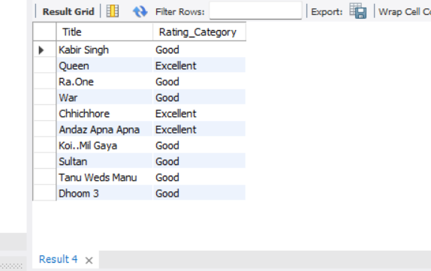
Write a query to select Title and a new column RatingCategory from the Movies table. If Rating is greater than 8.0, set RatingCategory to 'Excellent', otherwise 'Good’. Select Title, Case When Rating > 8.0 Then 'Excellent’Else 'Good’ End As Rating_Category From Movies;

Slide 10
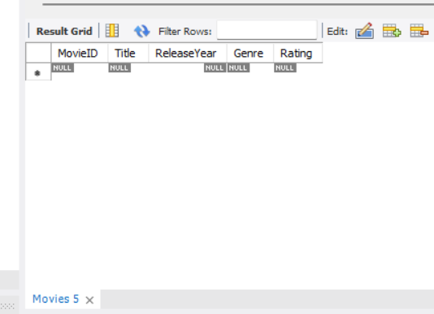
Write a query to find all movies that have been reviewed by more than 5 reviewers. Use a subquery to find these MovieIDs. Select * From Movies Where MovieID in (Select MovieID From Reviews Group by MovieID Having count(ReviewID) > 5);

Slide 11
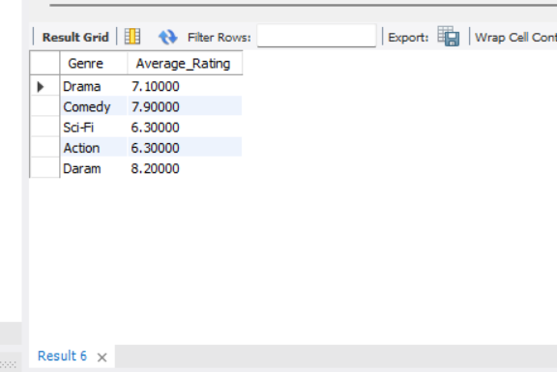
Write a query to get the average Rating for each Genre. Group the results by Genre. Select Genre, Avg(Rating) as Average_Rating From Movies Group By Genre;

Slide 12
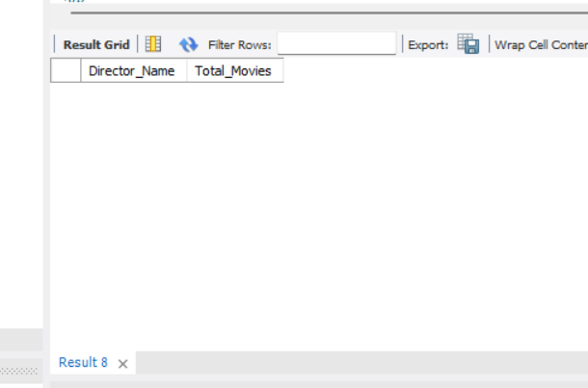
Write a query to get the total number of movies for each director, but only include directors who have directed more than 3 movies. Use the HAVING clause. Select Concat(d.FirstName, ' ', d.LastName) as Director_Name, Count(md.MovieID) as Total_Movies From Directors d Join MovieDirectors md ON d.DirectorID = md.DirectorID Join Movies m ON md.MovieID = m.MovieID Group By d.DirectorID, d.FirstName, d.LastName Having Count(md.MovieID) > 3;

Slide 13
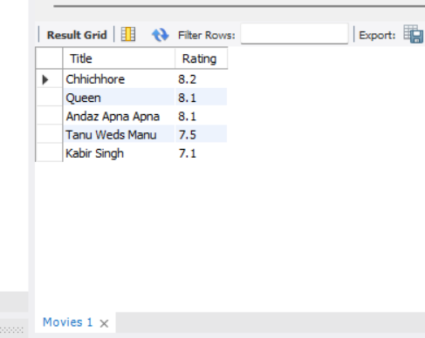
Write a query to select the top 5 highest-rated movies. Select Title, Rating From Movies Order By Rating Desc Limit 5;

Slide 14
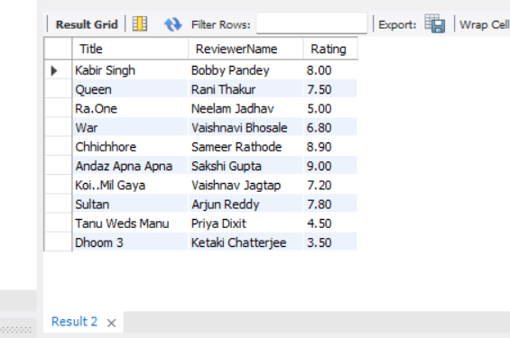
Write a query to join Movies with Reviews to get a list of all movies with their Title, ReviewerName, and Rating. Select m.Title, r.ReviewerName, r.Rating From Movies m Inner Join Reviews r on m.MovieID = r.MovieID;

Slide 15
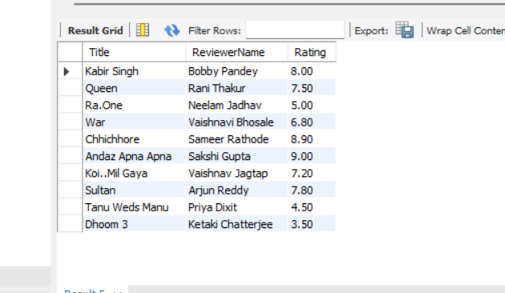
Write a query to get a list of all movies and any associated reviews. Include movies that might not have any reviews. Select m.Title, r.ReviewerName, r.Rating From Movies m left Join Reviews r on m.MovieID = r.MovieID;

Slide 16
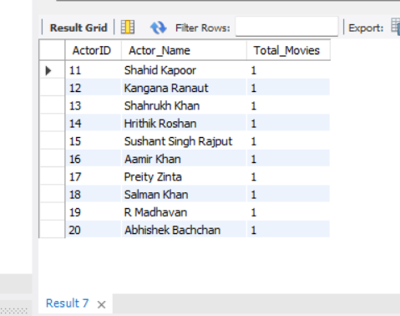
Write a query to get the total number of movies each actor has appeared in. Use an INNER JOIN between MovieActors and Actors, and group by ActorID. Select a.ActorID, Concat(a.FirstName, ' ', a.LastName) as Actor_Name, Count(ma.MovieID) as Total_Movies From MovieActors ma inner join Actors a on ma.ActorID = a.ActorId Group By a.ActorID, Concat(a.FirstName, ' ', a.LastName);

Slide 17
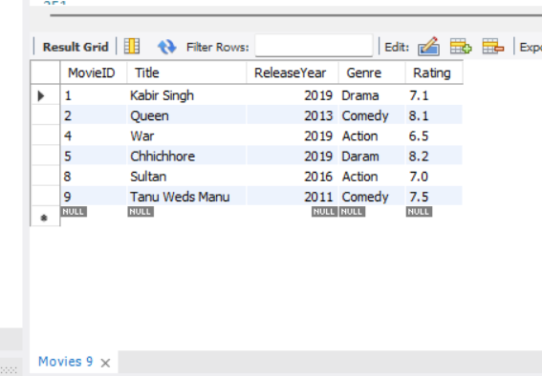
Write a query to find all movies directed by directors who were born after 1970. Use a subquery in the WHERE clause to find these DirectorIDs Select m.* From Movies m where m.MovieID in (Select md.MovieID From MovieDirectors md Join Directors d on md.DirectorID = d.DirectorID where d.BirthYear > 1970);

Slide 18
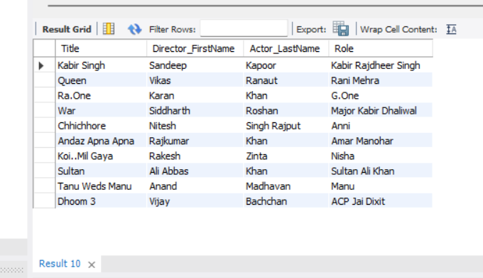
Write a query to list Title, FirstName (of the director), LastName (of the actor), and Role for all movies. Use INNER JOIN and LEFT JOIN as necessary to get all required details. Select m.Title, d.FirstName as Director_FirstName, a.LastName as Actor_LastName, ma.Role From Movies m Inner Join MovieDirectors md on m.MovieID = md.MovieID Inner Join Directors d on md.DirectorID = d.DirectorID Left join MovieActors ma on m.MovieID = ma.MovieID Left Join Actors a on ma.ActorID = a.ActorID;

